Slide 1
Lecture 13: Classical Lexical Semantics
USC CSCI 544: Applied Natural Language Processing
Jonathan May -- 梅約納
Nanyun (Violet) Peng -- 彭楠赟
October 10, 2018
slides from Dan Jurafsky and Nathan Schneider

Slide 2
What is Lexical Semantics
Word meanings that can help decide:
Word Similarity
Distributional (Vector) Models of Meaning
Word Relations
Word Sense Disambiguation
Semantic Role Labeling

Slide 3
Intuition of Semantic Similarity
Semantically Close
bank-money
apple-fruit
tree-forest
bank-river
pen-paper
run-walk
mistake-error
car-wheel
Semantically Distant
doctor-beer
painting-January
math-river
apple-penguin
nurse-fruit
pen-river
clown-rocket
car-algebra

Slide 4
Why Are Two Words Related?
Meaning
Two concepts are close in terms of meaning (want-desire)
World knowledge
Two concepts have similar properties, often occur together, or occur in similar contexts (pencil-pen, pen-ink, dog-cat)
Psychology
We often think of the two concepts together (death-taxes)

Slide 5
Two Types of Relations
Synonymy: two words are (roughly) interchangeable)
Semantic similarity (distance): two words are somehow "related"
Sometimes there's a clear lexical semantic relationship, often not

Slide 6
Validity of Semantic Similarity
Is semantic distance a valid linguistic phenomenon?
Experiment (Rubenstein and Goodenough, 1965)
Compiled a list of word pairs
Subjects asked to judge semantic distance (from 0 to 4) for each pair
Results
Rank correlation between subjects is ~ 0.9
People are consistent!

Slide 7
Why Do This
Task: automatically compute semantic similarity between words
Can be useful for many applications:
Detecting paraphrases (i.e. automatic essay grading, plagiarism detection)
Information Retrieval
Machine Translation
Why? because similarity gives us a way to generalize beyond word identities

Slide 8
Synonyms and near-synonymy: computing the similarity between words
“fast” is similar to “rapid”
“tall” is similar to “height”
Question answering:
Q: “How tall is Mt. Everest?” Candidate A: “The official height of Mount Everest is 29029 feet”

Slide 9
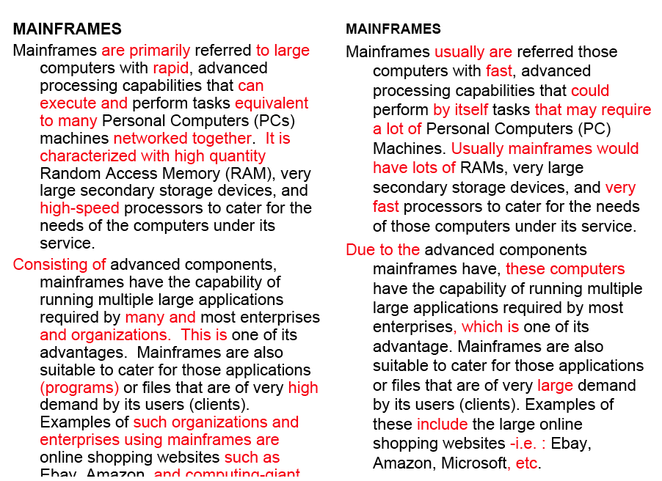
Word similarity for plagiarism detection

Slide 10
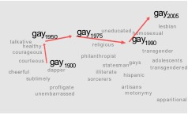
Word similarity for historical linguistics: semantic change over time
Sagi, Kaufmann, Clark 2013
Kulkarni, Al-Rfou, Perozzi, Skiena 2015
how general are terms over time?

Slide 11

Word similarity reflects gender stereotype
327 gender neutral occupations. Project on to she—he direction.
homemaker
receptionist
boss
maestro
she
he
nurse
philosopher
Crowdworkers rate each occup. for gender stereotype
Highly Correlated (Spearman ρ = 0.51)
Notes:
Besides, if we consider 327 gender neutral occupations based on US labor statistics and project them into gender direction defined by gender pronouns he and she. This gives a nice, immediate way to visualize the data, and it already suggests that there is quite a bit of gender stereotype. As you can see... To make this more systematic, we have an Amazon Mechanical Turk pipeline, where we ask 10 crowdworkers to rate each occupation as to how much it exhibits male or female stereotype.

Slide 12
Evaluation: Correlation with Humans
Ask humans and computer to rank pairs of words in order of semantic distance
Measure correlation

Slide 13
Evaluation: Word Choice Problems
Identify the alternative that is closest in meaning to the target
accidental
wheedle
ferment
inadvertent
abominate
imprison
incarcerate
writhe
meander
inhibit

Slide 14
Two classes of similarity algorithms
Thesaurus-based algorithms
Are words “nearby” in a thesaurus hierarchy?
Do words have similar glosses (definitions)?
Distributional algorithms
Do words behave similarly in real-world usage?

Slide 15
WordNet: Online thesaurus

Slide 16
WordNet 3.1
A hierarchically organized lexical database of English
On-line thesaurus + aspects of a dictionary
globalwordnet.org: wordnets in 50+ languages
quality/coverage/availability varies
Category | Unique Strings
Noun | 117,798
Verb | 11,529
Adjective | 22,479
Adverb | 4,481

Slide 17
Terminology: lemma and wordform
A lemma or citation form
Representation of all forms with the same stem, part of speech, rough semantics
A wordform
The inflected word as it appears in text
Wordform | Lemma
banks | bank
sung | sing
broken | break

Slide 18
Lemmas have senses
One lemma “bank” can have many meanings:
…a bank can hold the investments in a custodial account…
“…as agriculture burgeons on the east bank the river will shrink even more”
Sense (or word sense)
A discrete representation
of an aspect of a word’s meaning.
The lemma bank here has two senses
Sense 1:
1
Sense 2:
2

Slide 19
Homonymy: multi-sense as an artifact
Homonyms: words that share a form but have unrelated, distinct meanings:
bank₁: financial institution, bank₂: sloping land
bat₁: club for hitting a ball, bat₂: nocturnal flying mammal
Homographs (bank/bank, bat/bat)
Homophones:
Write and right
Piece and peace

Slide 20
Homonymy causes problems for NLP applications
Information retrieval
“bat care”
Machine Translation
bat: murciélago (animal) or bate (for baseball)
Text-to-Speech
bass (stringed instrument) vs. bass (fish)

Slide 21
Polysemy: related multi-sense
1. The bank was constructed in 1875 out of local red brick.
2. I withdrew the money from the bank
Are those the same sense?
Sense 2: “A financial institution”
Sense 1: “The building belonging to a financial institution”
A polysemous word has related meanings
Most non-rare words have multiple meanings

Slide 22
Metonymy or Systematic Polysemy: A systematic relationship between senses
Lots of types of polysemy are systematic
School, university, hospital
All can mean the institution or the building.
A systematic relationship:
Building Organization
Other such kinds of systematic polysemy:
Author (Jane Austen wrote Emma)
Works of Author (I love Jane Austen)
Tree (Plums have beautiful blossoms)
Fruit (I ate a preserved plum)

Slide 23
How do we know when a word has more than one sense?
The “zeugma” test: Two senses of serve?
Which flights serve breakfast?
Does Lufthansa serve Philadelphia?
?Does Lufthansa serve breakfast and San Jose?
Since this conjunction sounds weird,
we say that these are two different senses of “serve”

Slide 24
Synonyms
Word that have the same meaning in some or all contexts.
filbert / hazelnut
couch / sofa
big / large
automobile / car
vomit / throw up
Water / H₂0
Two lexemes are synonyms
if they can be substituted for each other in all situations
If so they have the same propositional meaning

Slide 25
Synonyms
But there are few (or no) examples of perfect synonymy.
Even if many aspects of meaning are identical
Still may not preserve the acceptability based on notions of politeness, slang, register, genre, etc.
Example:
Water/H₂0
Big/large
Brave/courageous
Notes:
Big more colloquial

Slide 26
Synonymy is a relation between senses rather than words
Consider the words big and large
Are they synonyms?
How big is that plane?
Would I be flying on a large or small plane?
How about here:
Miss Nelson became a kind of big sister to Benjamin.
?Miss Nelson became a kind of large sister to Benjamin.
Why?
big has a sense that means being older, or grown up
large lacks this sense

Slide 27
Antonyms
Senses that are opposites with respect to one feature of meaning
Otherwise, they are very similar!
dark/light short/long fast/slow rise/fall
hot/cold up/down in/out
More formally: antonyms can
define a binary opposition
or be at opposite ends of a scale
long/short, fast/slow
Be reversives:
rise/fall, up/down

Slide 28
Hyponymy and Hypernymy
One sense is a hyponym of another if the first sense is more specific, denoting a subclass of the other
car is a hyponym of vehicle
mango is a hyponym of fruit
Conversely hypernym/superordinate (“hyper is super”)
vehicle is a hypernym of car
fruit is a hypernym of mango
Superordinate/hyper | vehicle | fruit | furniture
Subordinate/hyponym | car | mango | chair

Slide 29
Hyponymy more formally
Extensional:
The class denoted by the superordinate extensionally includes the class denoted by the hyponym
Entailment:
A sense A is a hyponym of sense B if being an A entails being a B
Hyponymy is usually transitive
(A hypo B and B hypo C entails A hypo C)
Another name: the IS-A hierarchy
A IS-A B (or A ISA B)
B subsumes A

Slide 30
Hyponyms and Instances
WordNet has both classes and instances.
An instance is an individual, a proper noun that is a unique entity
San Francisco is an instance of city
But city is a class
city is a hyponym of municipality...location...

Slide 31
Meronymy
The part-whole relation
A leg is part of a chair; a wheel is part of a car.
Wheel is a meronym of car, and car is a holonym of wheel.

Slide 32
How is “sense” defined in WordNet?
The synset (synonym set), the set of near-synonyms, instantiates a sense or concept, with a gloss
Example: chump as a noun with the gloss:
“a person who is gullible and easy to take advantage of”
This sense of “chump” is shared by 9 words:
chump¹, fool², gull¹, mark⁹, patsy¹, fall guy¹, sucker¹, soft touch¹, mug²
Each of these senses have this same gloss
(Not every sense; sense 2 of gull is the aquatic bird)

Slide 33
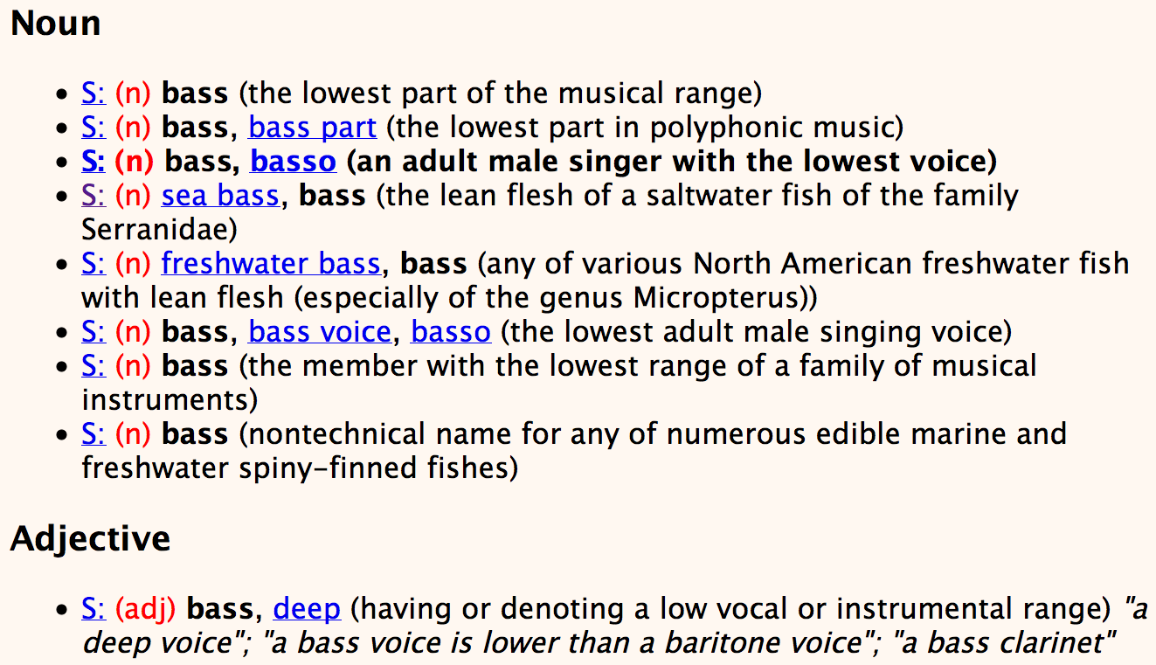
Senses of “bass” in Wordnet

Slide 34
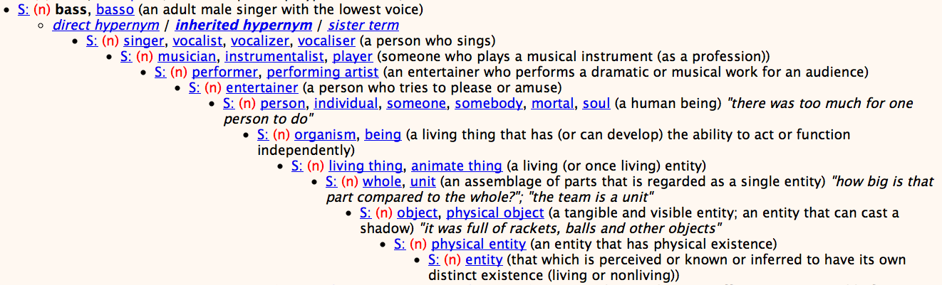
WordNet Hypernym Hierarchy for “bass”

Slide 35
WordNet Noun Relations
Notes:
Meronym: part-whole

Slide 36
WordNet VerbRelations

Slide 37
WordNet: Viewed as a graph

Slide 38
“Supersenses” The top level hypernyms in the hierarchy
(counts from Schneider and Smith 2013’s Streusel corpus)

Slide 39
Supersenses
A word’s supersense can be a useful coarse-grained representation of word meaning for NLP tasks

Slide 40
WordNet 3.1
Where it is:
http://wordnetweb.princeton.edu/perl/webwn
Libraries
Python: WordNet from NLTK
http://www.nltk.org/Home
Java:
JWNL, extJWNL on sourceforge

Slide 41
Word Similarity
Synonymy: a binary relation
Two words are either synonymous or not
Similarity (or distance): a looser metric
Two words are more similar if they share more features of meaning
Similarity is properly a relation between senses
The word “bank” is not similar to the word “slope”
Bank¹ is similar to fund³
Bank² is similar to slope⁵
But we’ll compute similarity over both words and senses

Slide 42
Why word similarity
A practical component in lots of NLP tasks
Question answering
Natural language generation
Automatic essay grading
Plagiarism detection
A theoretical component in many linguistic and cognitive tasks
Historical semantics
Models of human word learning
Morphology and grammar induction

Slide 43
Word similarity and word relatedness
We often distinguish word similarity from word relatedness
Similar words: near-synonyms
Related words: can be related any way
car, bicycle: similar
car, gasoline: related, not similar

Slide 44
Thesaurus-based similarity algorithms
Thesaurus-based algorithms
Are words “nearby” in hypernym hierarchy?
Do words have similar glosses (definitions)?
Distributional algorithms
Do words have similar distributional contexts?

Slide 45
Path based similarity
Two concepts (senses/synsets) are similar if they are near each other in the thesaurus hierarchy
=have a short path between them
concepts have path 1 to themselves

Slide 46
Refinements to path-based similarity
pathlen(c₁,c₂) = 1 + number of edges in the shortest path in the hypernym graph between sense nodes c₁ and c₂
simpath(c₁,c₂) =
ranges from 0 to 1
wordsim(w₁,w₂) = max simpath(c₁,c₂)
c₁∈senses(w₁),
c₂∈senses(w₂)

Slide 47
Example: path-based similarity simpath(c₁,c₂) = 1/pathlen(c₁,c₂)
simpath(nickel,coin) = 1/2 = .5
simpath(fund,budget) = 1/2 = .5
simpath(nickel,currency) = 1/4 = .25
simpath(nickel,money) = 1/6 = .17
simpath(nickel,standard) = 1/6 = .17
Notes:
Interaction ask students to compute

Slide 48
Problem with basic path-based similarity
Assumes each link represents a uniform distance
But nickel to money seems to us to be closer than nickel to standard
Nodes high in the hierarchy are very abstract
We instead want a metric that
Represents the cost of each edge independently
Words connected only through abstract nodes are less similar

Slide 49
Information content similarity metrics
Resnik 1995
Let’s define P(c) as:
The probability that a randomly selected word in a corpus is an instance of concept c
For a given concept, each observed noun is either
a member of that concept with probability P(c)
not a member of that concept with probability 1-P(c)
All words are members of the root node (Entity)
P(root)=1
The lower a node in hierarchy, the lower its probability

Slide 50
Information content similarity
entity
…
geological-formation
Train by counting in a corpus
Each instance of hill counts toward frequency
of natural elevation, geological formation, entity, etc
Let words(c) be the set of all words that are children of node c, +c
words(“geo-formation”) = {hill,ridge,grotto,coast,cave,shore,natural elevation, geo-formation}
words(“natural elevation”) = {hill, ridge, natural elevation}
natural elevation
cave
shore
hill
ridge
grotto
coast
N = words in the corpus

Slide 51
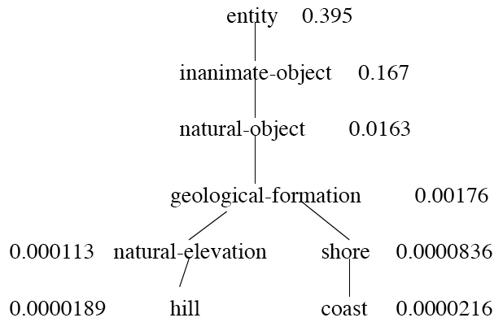
Information content similarity
WordNet hierarchy augmented with probabilities P(c)
D. Lin. 1998. An Information-Theoretic Definition of Similarity. ICML 1998

Slide 52
Information content: definitions
1.3 bits
Information content:
IC(c) = -log P(c)
Most informative subsumer (Lowest common subsumer)
LCS(c₁,c₂) =
The most informative (lowest) node in the hierarchy subsuming both c₁ and c₂
5.9 bits
9.1 bits
15.7 bits

Slide 53
Using information content for similarity: the Resnik method
Philip Resnik. 1995. Using Information Content to Evaluate Semantic Similarity in a Taxonomy. IJCAI 1995.
Philip Resnik. 1999. Semantic Similarity in a Taxonomy: An Information-Based Measure and its Application to Problems of Ambiguity in Natural Language. JAIR 11, 95-130.
The similarity between two words is related to their common information
The more two words have in common, the more similar they are
Resnik: measure common information as:
The information content of the most informative
(lowest) subsumer (MIS/LCS) of the two nodes
sim_{resnik}(c₁,c₂) = -log P( LCS(c₁,c₂) )

Slide 54
Other thesaurus-based similarity metrics
Notes:
Jiangconrath: mutual information inspired.

Slide 55
Thesaurus Methods: Limitations
Measure is only as good as the resource
Limited in scope
Assumes IS-A relations
Works mostly for nouns
Role of context not accounted for
Not easily domain-adaptable
Resources not available in many languages

